Slide 1
Team Data Dominators
Kumar Aditya & Harneet Singh Channa

Slide 2
Problem Statement
Need for an efficient and distributed system to detect Inclusion Dependencies (INDs) in large datasets.
Challenges include:
Splitting and managing large data.
Avoiding redundant computations.
Dynamic workload distribution among workers.
Efficient termination handling when no tasks remain.

Slide 3
Solution Overview
Actor-based system with distributed processing.
Four main components:
DependencyMiner (Master): Orchestrates tasks and manages workers.
DependencyWorker (Worker): Validates IND tasks.
InputReader: Reads and preprocesses data from files.
ResultCollector: Aggregates and stores results.
Built-in optimization:
Skipping already validated tasks.
Dynamic batch size adjustment based on task performance.

Slide 4
Workflow Overview
Input Reader
Reads large datasets row by row.
Splits the single-column data into multiple fields based on a delimiter.
DependencyMiner:
Generates task candidates and validates dependencies.
Assigns tasks to workers while avoiding duplicates.
Handles task and worker termination gracefully.
Dependency Worker:
Processes assigned tasks.
Skips tasks if dependencies are already validated.
Result Collector:
Collects validated INDs and stores them in the output file.

Slide 5
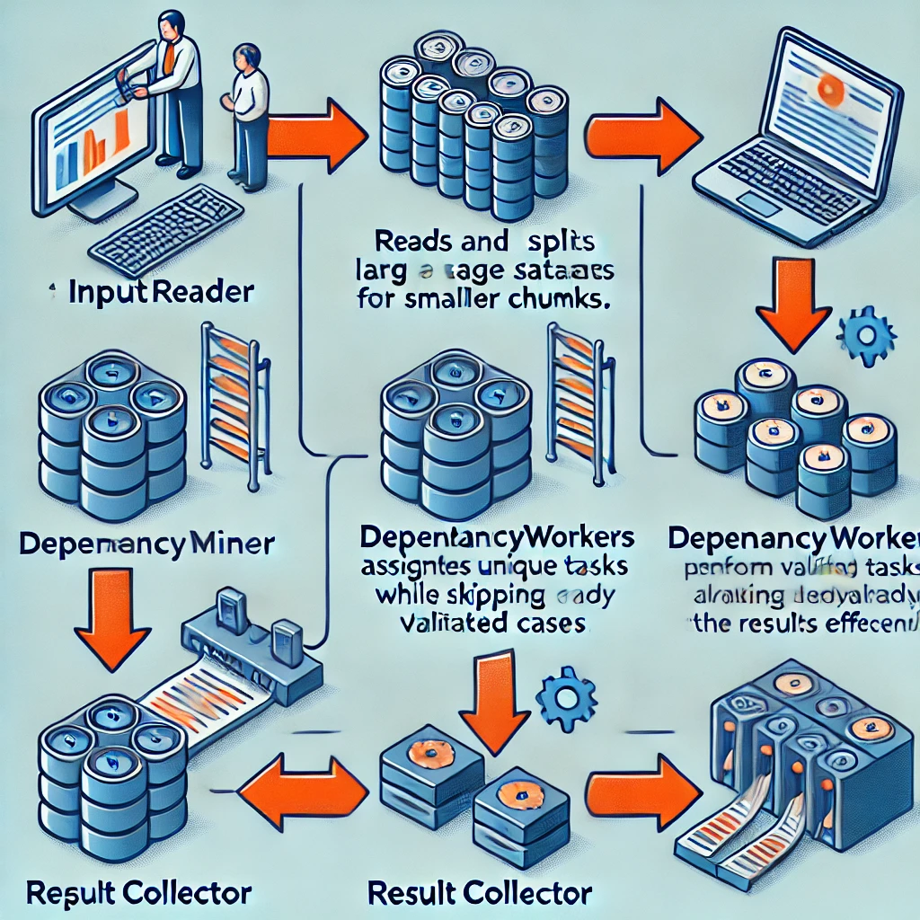
Workflow Diagram

Slide 6
Key Features
Avoidance of redundant tasks by tracking validated column pairs.
Dynamic batch size adjustment for performance optimization.
Graceful termination of idle workers and master.
Scalable architecture for distributed systems.

Slide 7
Code Implementation Highlights
DependencyMiner:
isAlreadyValidated(): Ensures no duplicate validations.
sendValidationTask(): Assigns tasks only to available workers.
DependencyWorker:
Skips tasks if dependencies are already validated.
InputReader:
Splits data into multiple columns.
ResultCollector:
Stores unique results in the output file.

Slide 8
Dynamic Batch Size Adjustment
Mechanism to adjust batch size:
Increase size for fast tasks.
Decrease size for slow tasks.
Benefits:
Improved throughput.
Balanced workload distribution.
Code Reference:
adjustBatchSize() in DependencyMiner.

Slide 9
Optimization Strategies
Redundant task elimination.
Dynamic worker-task load balancing.
Efficient resource utilization through graceful shutdown.

Slide 10
Conclusion
Efficient and scalable system for large-scale IND detection.
Key achievements:
Avoided redundant computations.
Optimized resource utilization.
Enhanced system scalability.

